Slide 1
Django
By Forrest Gile & Ryan Dreyer

Slide 2
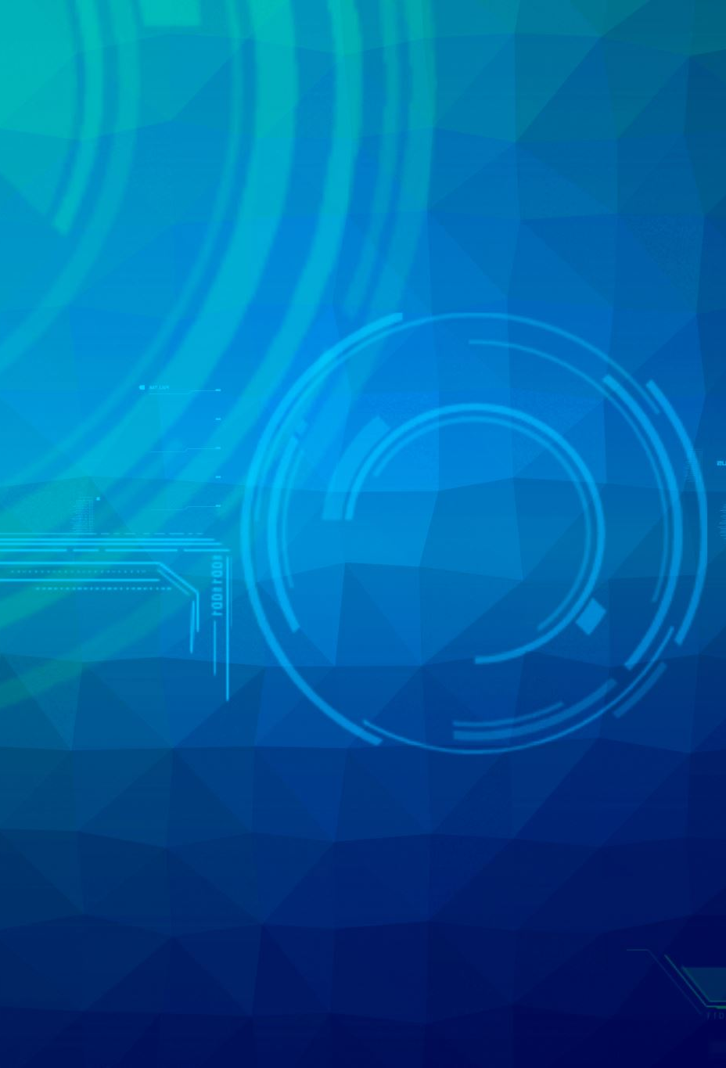
What is Django
Django is a high-level Python web framework that enables rapid development of secure and maintainable websites
Django follows the "Batteries included" philosophy
Notes:
Batteries included = the product comes together with all possible parts required for full usability.

Slide 3

Why to use
Simple syntax
Can create its own web server
DRY philosophy — Don’t Repeat Yourself
Notes:
DRY philosophy — Don’t Repeat Yourself — which means developers can reuse existing code and focus on the unique one

Slide 4
When to use Django
You need to develop a web app or API backend
The app must be secure from most common vulnerabilities and attacks by default. For example, CSRF, SQL Injection, XSS, Clickjacking, etc
You don’t want to work with database queries directly
You want to use open-source software

Slide 5
When not to use
Your app is extremely huge
You need to build a very basic app, which does not require database, file operations, or anything even remotely complex
You want to build everything from scratch
You or your team members are not familiar with Django/Python at all, and you can’t afford to invest time and resources to gather the required skills
Notes:
You want to build everything from scratch = mention flask

Slide 6
Cited Sources
“When to Use Django (and When Not To).” Crowdbotics, www.crowdbotics.com/blog/when-to-use-django-and-when-not-to. Accessed 28 Nov. 2023.
MozDevNet. “Django Introduction - Learn Web Development: MDN.” MDN Web Docs, developer.mozilla.org/en-US/docs/Learn/Server-side/Django/Introduction. Accessed 28 Nov. 2023.
Korsun, Julia. “Why We Use Django Framework & What Is Django Best Used For.” Software Development Blog & IT Tech Insights | Django Stars, 13 Nov. 2023, djangostars.com/blog/why-we-use-django-framework/.

